Slide 1


Unlocking Efficiency: An Exploration of Garment Worker Performance Factors
Anish Kolaparthi

Slide 2

Problem Statement
The garment industry faces intense global competition and constant pressure to meet rising demand.
Worker productivity is a crucial factor in determining the success and profitability of garment manufacturing companies.
Understanding the factors influencing worker productivity is essential for optimizing production processes and resource allocation.
Traditional methods for assessing and improving worker productivity often rely on subjective observations and limited data.
There is a need for data-driven approaches to accurately predict, analyze, and enhance worker productivity in the garment industry.
This study aims to address this need by leveraging data analytics techniques to uncover the key drivers of garment worker productivity and develop a predictive model to guide decision-making.

Slide 3
Stakeholders
Stakeholder | Role | Interest | What They Want to Know
Garment Manufacturers | Production and business owners | Profitability, efficiency, competitiveness | Key drivers of productivity, impact of different factors on performance, ways to optimize production processes and resource allocation
Production Managers & Supervisors | Overseeing worker performance, production planning | Meeting production targets, team efficiency, worker performance improvement | Individual and team productivity levels, identification of bottlenecks and areas for improvement, effectiveness of different management strategies
Workers | Performing production tasks | Fair wages, good working conditions, skill development, job satisfaction | Factors influencing their productivity, fairness of incentive structures, opportunities for training and skill development, impact of work environment on performance
Brands & Retailers | Sourcing garments, ensuring ethical production | Supply chain transparency, ethical sourcing, worker well-being | Worker productivity levels within their supply chain, compliance with labor standards, factors impacting worker well-being and satisfaction
Government Agencies & Regulators | Policy development, industry oversight | Labor rights protection, fair labor practices, industry growth | Industry-wide productivity trends, compliance with labor laws, factors impacting worker well-being, data for policy development and industry monitoring
Industry Associations & Research Institutions | Industry development, research & training | Best practices, industry advancement, knowledge sharing | Factors influencing worker productivity across the industry, best practices for improving performance, data for research and development of training programs

Slide 4
Research Questions
Research Question | Data Analytics Technique | Expected Outcome
How does the distribution of worker productivity vary across different teams or time periods? | Histograms, box plots, time series plots | Visual identification of trends, patterns, and outliers in worker productivity data.
Is there a visual correlation between specific factors (e.g., overtime, style changes) and worker productivity? | Scatter plots, heatmaps | Exploration of potential relationships between variables and identification of areas for further analysis.
What are the average, median, and range of worker productivity across the dataset? | Measures of central tendency and dispersion | Understanding of the overall distribution and variability of worker productivity.
How does worker productivity vary based on factors such as experience level, skill set, or team size? | Grouped summary statistics, cross-tabulation | Insights into how different worker characteristics or team compositions relate to productivity levels.
Can we develop a regression model to predict worker productivity based on factors like overtime, number of workers, and style changes? | Linear regression, decision tree regression | A predictive model that estimates worker productivity based on identified factors.
How accurately can this model predict actual productivity levels? | Model evaluation metrics (R-squared, MSE, RMSE) | Assessment of the model's predictive power and identification of areas for potential improvement.
Is there a statistically significant difference in productivity between teams with high and low levels of overtime? | Independent samples t-test | Determination of whether observed differences in productivity between groups are statistically significant or due to chance.
Do workers with higher levels of experience exhibit significantly higher productivity compared to less experienced workers? | Independent samples t-test | Evaluation of the impact of experience on worker productivity and potential implications for training and development programs.
Is there a correlation between the number of style changes and worker productivity? | Correlation coefficient (Pearson's r) | Understanding the strength and direction of the relationship between style changes and worker productivity.
Does worker productivity correlate with the amount of idle time experienced by the team? | Correlation coefficient (Pearson's r) | Analysis of the relationship between idle time and productivity, and potential implications for process optimization.

Slide 5
Dataset
Variable | Type | Description | Input/Output
date | Date | Date of the observation (MM-DD-YYYY) | Input
day | Categorical | Day of the week | Input
quarter | Categorical | A portion of the month (month divided into four quarters) | Input
team_no | Numerical | Associated team number | Input
no_of_workers | Numerical | Number of workers in each team | Input
no_of_style_change | Numerical | Number of changes in product style | Input
targeted_productivity | Numerical | Target productivity set for each team each day | Input
smv | Numerical | Standard Minute Value (allocated time for a task) | Input
wip | Numerical | Work in progress (number of unfinished items) | Input
over_time | Numerical | Overtime by each team in minutes | Input
incentive | Numerical | Financial incentive amount (in BDT) | Input
idle_time | Numerical | Production interruption time in minutes | Input
idle_men | Numerical | Number of idle workers due to interruption | Input

Slide 6
Data Processing
Variable Removal:
WIP (Work in Progress): As WIP doesn't directly translate to productivity and its influence is likely captured through other variables like idle time and production volume, it was excluded from the analysis.
Date: Since the average productivity remained consistent across different dates, the "date" variable was deemed irrelevant for predicting productivity and was removed.
Categorical Variable Transformation:
Quarter: The term "Quarter" was removed from the categorical variable, leaving only the numerical representation (1, 2, 3, 4) for each quarter of the month.
Day: The days of the week were converted from categorical labels (e.g., Monday, Tuesday) to numerical values (1 to 7) to facilitate quantitative analysis.
Department Encoding:
Department Type: The categorical variable representing the type of department (Sweing or Finishing) was encoded numerically, with Sewing assigned a value of 1 and Finishing assigned a value of 2.

Slide 7
Descriptive Statistics

Slide 8



Histogram

Slide 9
Box Plots

Slide 10
Scatter plots

Slide 11
Correlation
Targeted Productivity: Exhibits the strongest positive correlation (0.42) with actual productivity, suggesting that setting clear and achievable targets can significantly impact worker performance.
Number of Style Changes: Shows a strong negative correlation (-0.21) with actual productivity, indicating that frequent style changes can hinder worker efficiency, potentially due to increased complexity and adjustment time.
Idle Men: Has a moderate negative correlation (-0.18) with actual productivity, implying that production interruptions and idle workers negatively impact overall output.
Team: Displays a moderate negative correlation (-0.15) with actual productivity, suggesting that larger teams might be less efficient than smaller, more focused teams. However, further investigation is needed to understand the dynamics of team size and productivity.
SMV (Standard Minute Value): Shows a weak negative correlation (-0.12) with actual productivity, potentially indicating that tasks with higher allocated times may be less efficient or prone to delays.
Department, Incentive, Overtime, Number of Workers: These variables exhibit weak positive or negative correlations with actual productivity, suggesting a less pronounced or more complex relationship with worker performance. Further analysis is needed to understand the nuances of these relationships and their potential impact.
Day and Quarter: Show very weak correlations with actual productivity, indicating that these temporal factors have minimal influence on worker performance.

Slide 12
T Test
Hypothesis:
Null Hypothesis (H0): There is no significant difference in average actual productivity between the Sewing and Finishing departments.
Alternative Hypothesis (H1): There is a significant difference in average actual productivity between the Sewing and Finishing departments.
Conclusion:
The t-test resulted in a t-statistic of -3.04 and a p-value of 0.0024 (two-tailed). Since the p-value is less than the significance level of 0.05, we reject the null hypothesis. This indicates that there is a statistically significant difference in average actual productivity between the Sewing and Finishing departments.

Slide 13
Regression Summary

Slide 14
Regression Statistics
Model Significance and Fit:
The model explains 42.7% of the variance in actual productivity, indicating a reasonably good fit.
The model is statistically significant, meaning the observed relationships are unlikely due to chance.
The average prediction error is 0.133, suggesting the model's predictions are relatively close to actual values.
Significant Predictors of Productivity:
Targeted Productivity: Setting clear and achievable goals has the strongest positive impact on worker performance.
Department: The Finishing department exhibits higher average productivity compared to the Sewing department.
Incentive: Financial incentives effectively motivate workers and boost productivity.
Team Size: Larger teams tend to be associated with lower productivity.
Task Complexity (SMV): Tasks with higher allocated times may lead to lower productivity.
Less Influential Factors:
Day of the week, quarter of the month, overtime, idle time, and number of style changes do not significantly impact productivity in this model.
Recommendations:
Focus on setting clear and achievable productivity targets.
Investigate and address productivity differences between departments.
Utilize financial incentives strategically to motivate workers.
Optimize team structures and task allocation processes.

Slide 15
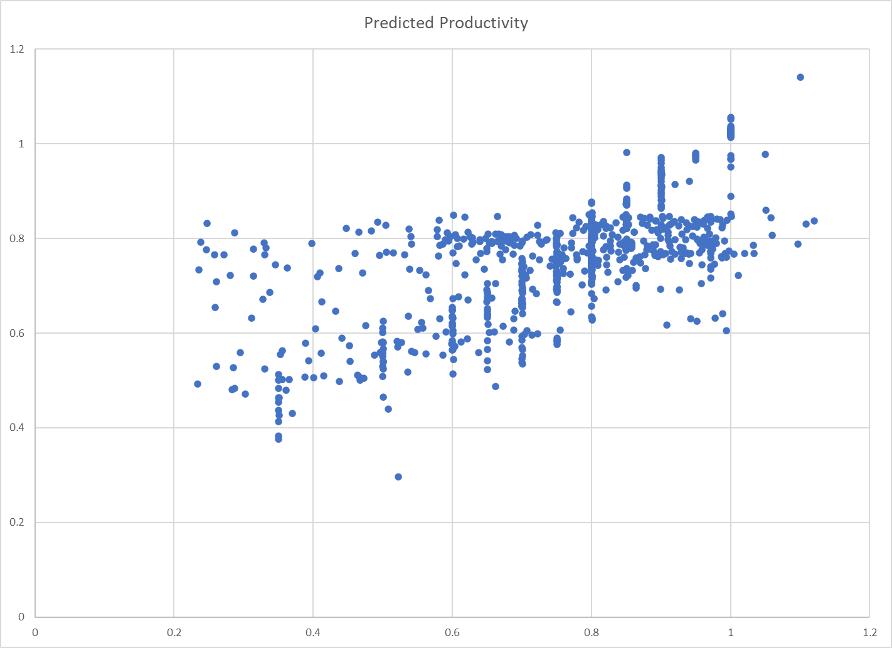
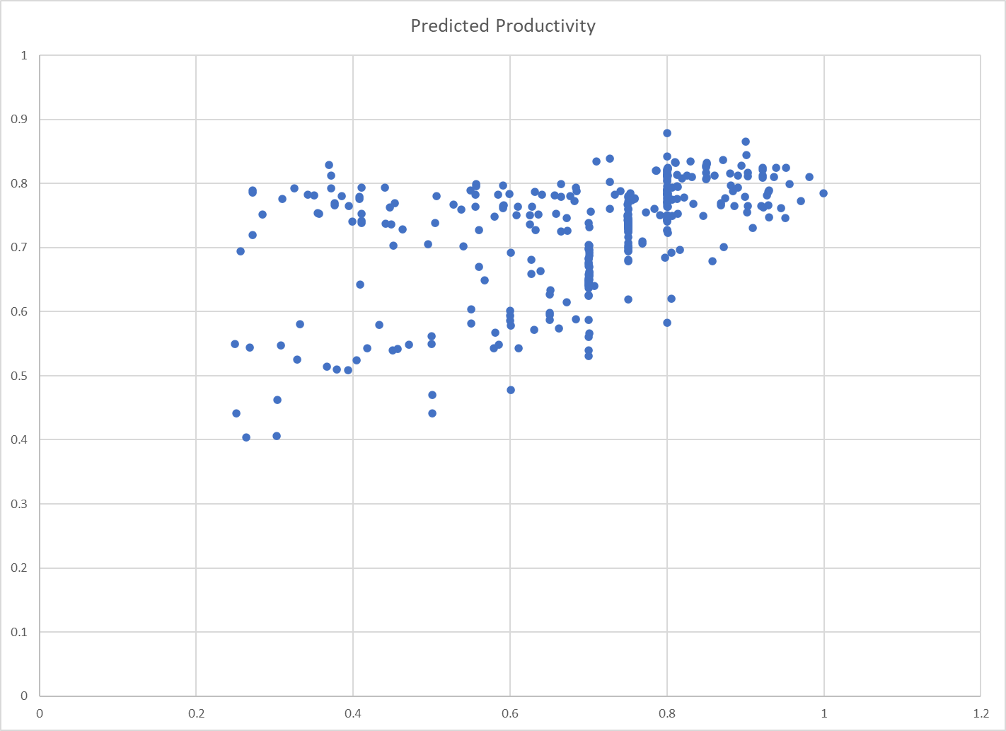
Results

Slide 16
Conclusion
Data-driven insights provide a valuable understanding of the factors influencing garment worker productivity.
Targeted productivity, department type, and incentives play significant roles in worker performance.
The developed regression model can effectively predict worker productivity based on key factors.
Further investigation is needed to understand the nuances of team size, task complexity, and departmental differences in productivity.
Recommendations include setting clear goals, optimizing team structures, utilizing incentives strategically, and addressing departmental disparities.
Continuous monitoring and refinement of the model are crucial for maintaining its accuracy and relevance.
By implementing data-driven strategies, garment manufacturers can enhance worker productivity, optimize production processes, and gain a competitive edge.

Slide 17
Thank You

